Slide 1
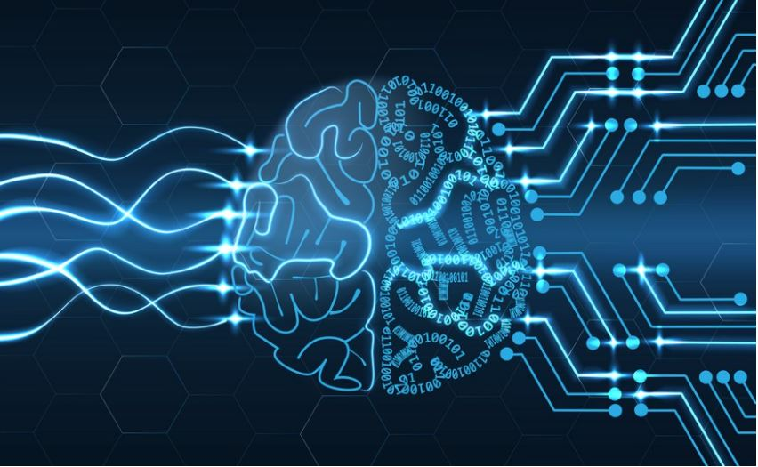
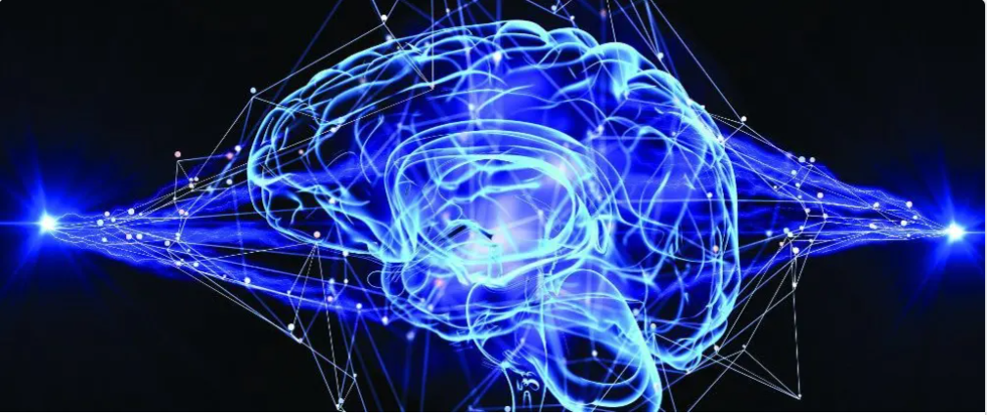
TOPIC:PNEUMONIA PREDICTION USING CONVOLUTIONAL NEURAL NETWORK[CNN]
-------- THE DEEP LEARNING ALGORITHM

Slide 2
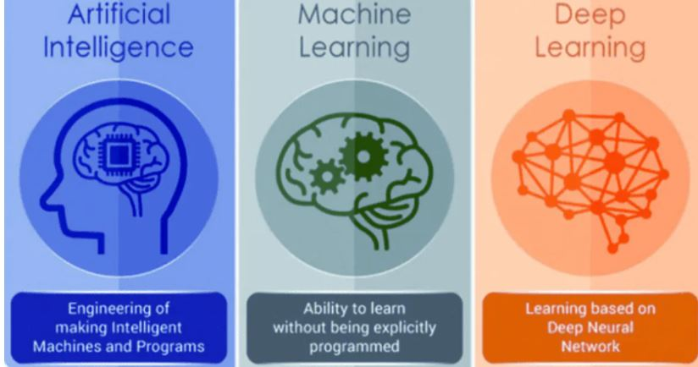
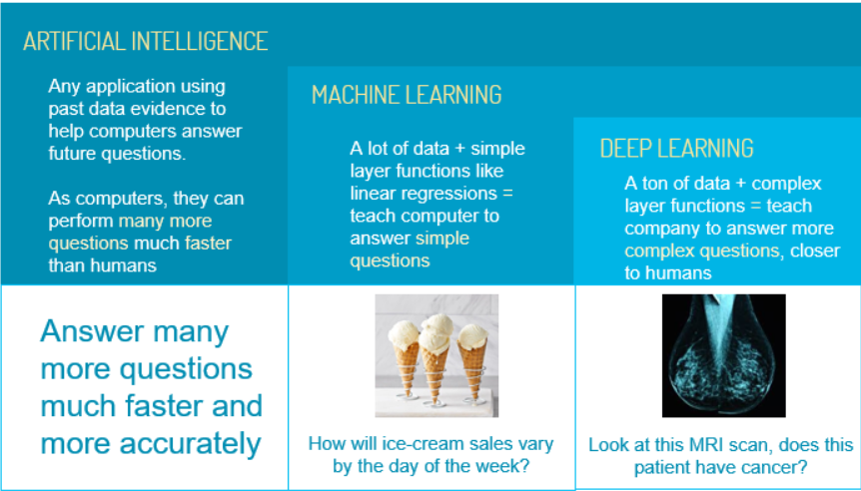
THE DOMAIN OF DEEP LEARNING IS MACHINE LEARNING , MACHINE LEARNING IS ARTIFICIAL INTELLIGENCE. SO, they are interlinked to each other.

Slide 3
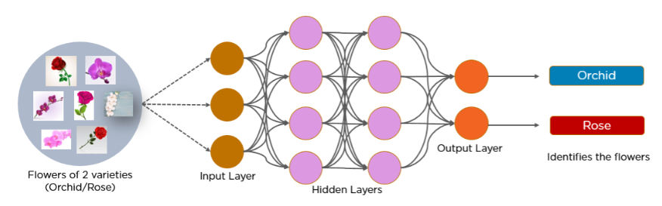
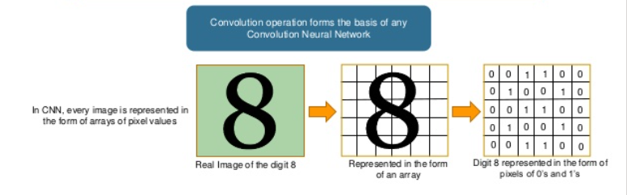
INTRODUCTION TO CNN[CONVOLUTIONAL NEURAL NETWORK]
CNN is a feed forward neural network that is used to generally used to analyze visual images by processing data with grid like topology. A CNN is also known as “ConvNet”
CNN is a feed forward neural network that is generally used to analyze visual images by processing data with grid like topology

Slide 4
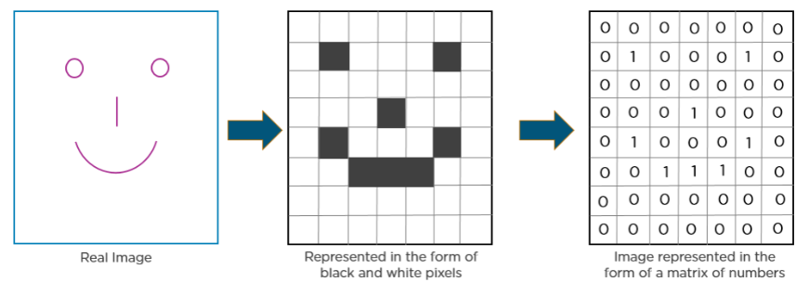
HOW CNN RECOGNIZES THE IMAGES ?

Slide 5
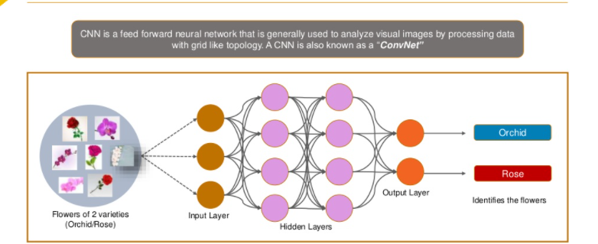
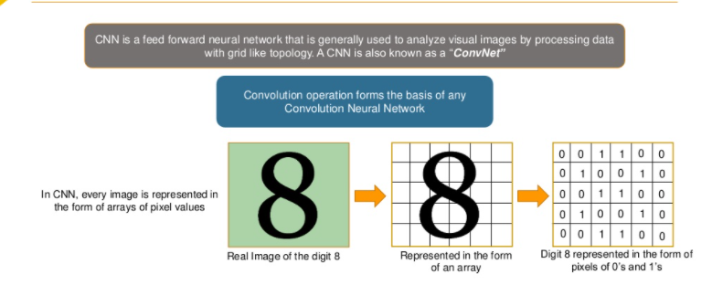
INTRODUCTION TO CNN[CONVOLUTIONAL NEURAL NETWORK]

Slide 6


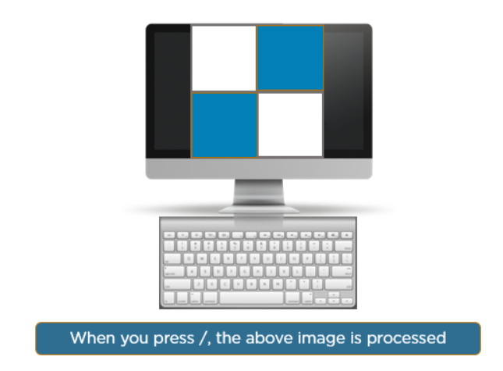
Consider the following images: The boxes that are colored represent a pixel value of 1, and 0 if not colored.
:

Slide 7
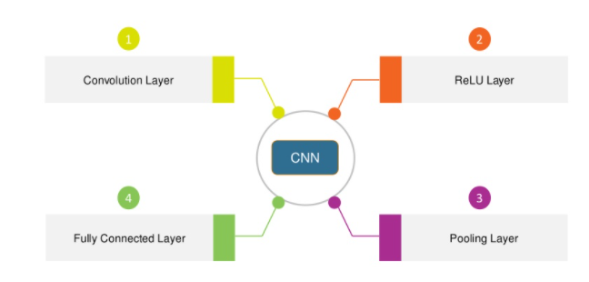
LAYERS IN A CONVOLUTIONAL NEURAL NETWORK:
A convolutional Neural Network has multiple hidden layers that help in extracting in information from an image. The four important layers in CNN are:

Slide 8
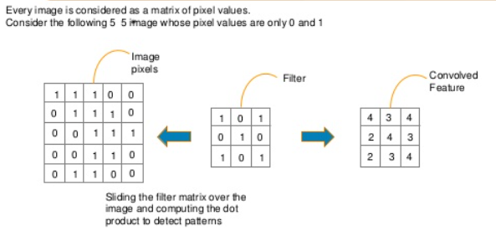
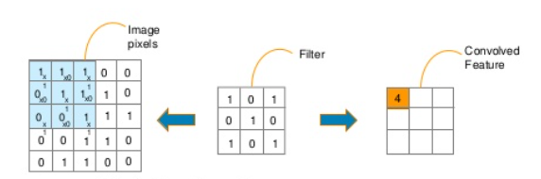
1.CONVOLUTIONAL LAYER:
A Convolution layer has a number of filters that perform convolution operation.
The key building block in a convolutional neural network is the convolutional layer. We can visualize a convolutional layer as many small square templates, called convolutional kernels, which slide over the image and look for patterns. Where that part of the image matches the kernel’s pattern, the kernel returns a large positive value, and when there is no match, the kernel returns zero or a smaller value.

Slide 9
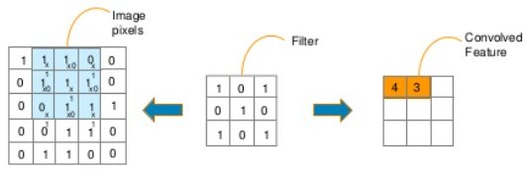
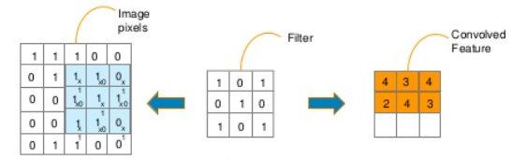
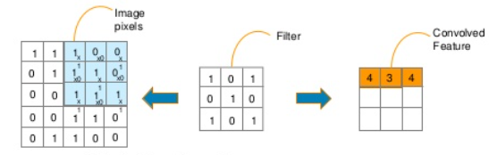
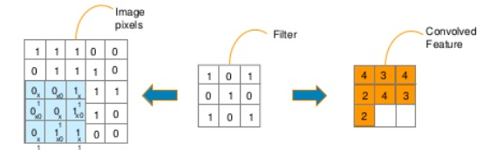
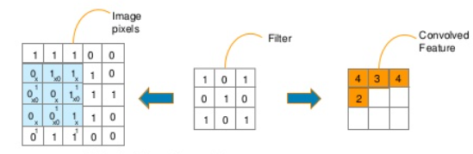
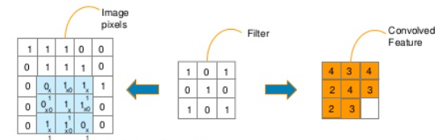
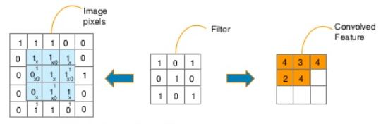
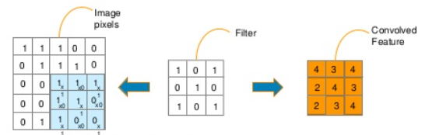

Slide 10
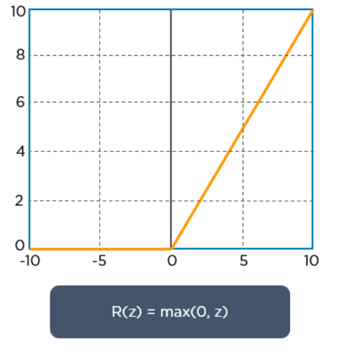
2.RELU LAYER:
ReLU stands for the rectified linear unit. Once the feature maps are extracted, the next step is to move them to a ReLU layer.
RELU FUNCTION
ReLU performs an element-wise operation and sets all the negative pixels to 0. It introduces non-linearity to the network, and the generated output is a rectified feature map. Below is the graph of a ReLU function.

Slide 11
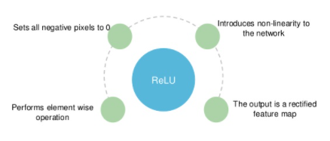
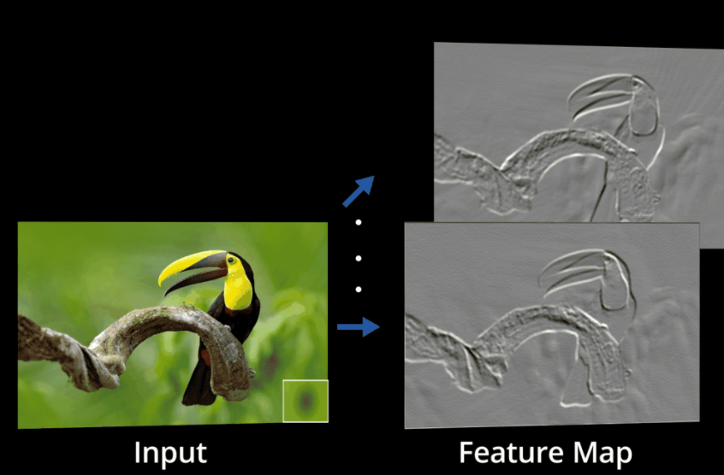
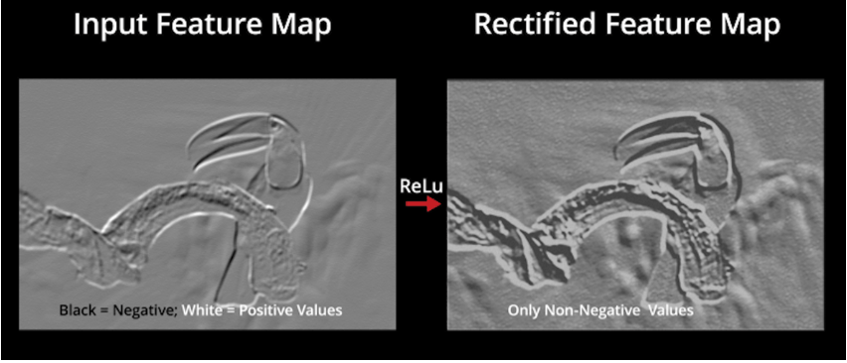
The original image is scanned with multiple convolutions and RELU layers for locating the features.

Slide 12
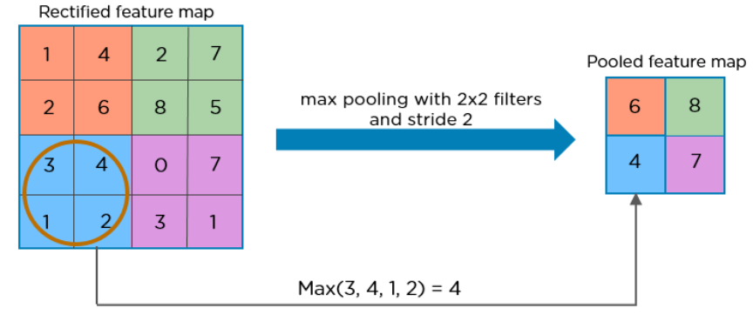
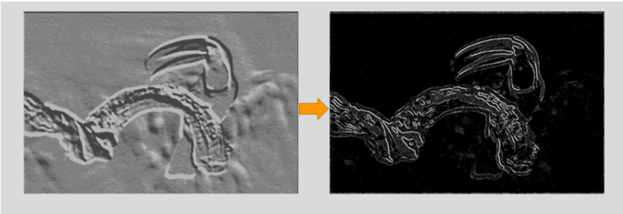
3.POOLING LAYER:
Pooling is a down sampling operation that reduces the dimensionality of the feature map. The rectified feature map now goes through a pooling layer to generate a pooled feature map.
The pooling layer uses various filters to identify different parts of the images like edges, corners, body, feathers, eyes and beak.

Slide 13
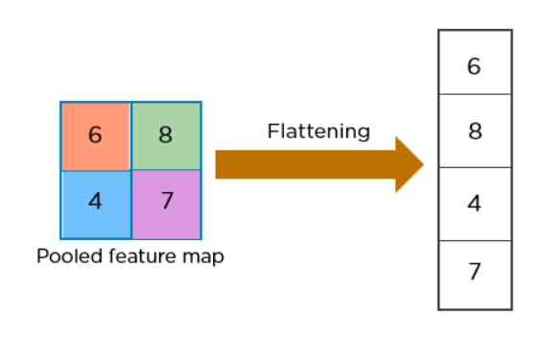
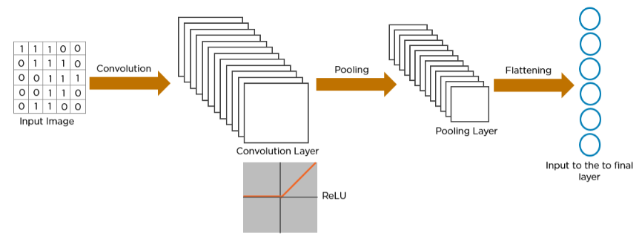
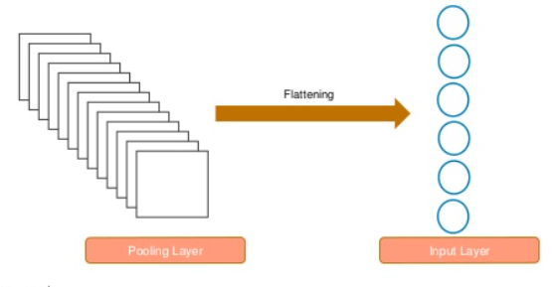
FLATTENING:
Flattening is the process of converting all the resultant 2-d dimensional arrays from pooled feature map into a single long continuous linear vector.
The structure of the network so far :

Slide 14
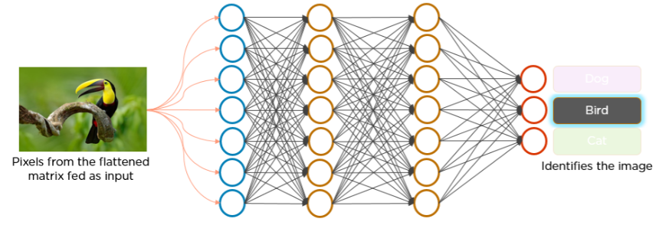
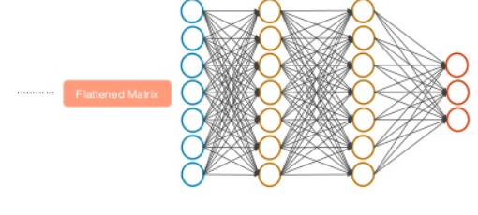
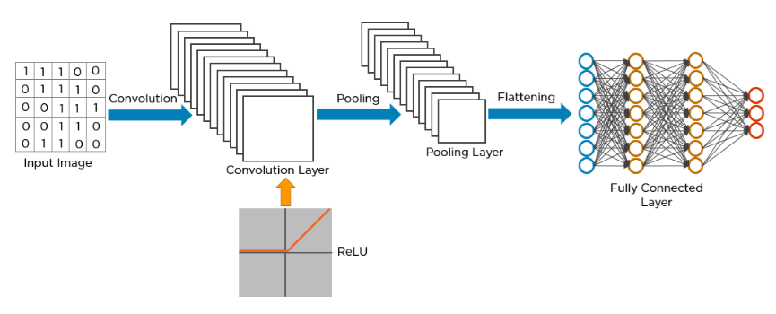
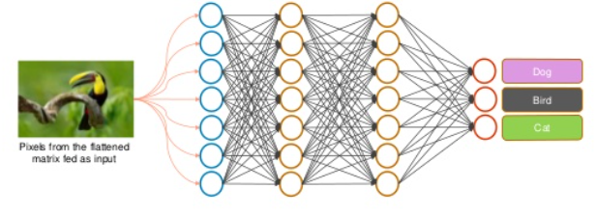
4.FULLY CONNECTED LAYER:
The flattend matrix from the pooling layer is fed as input to the Fully connected Layer to classify the image.

Slide 15
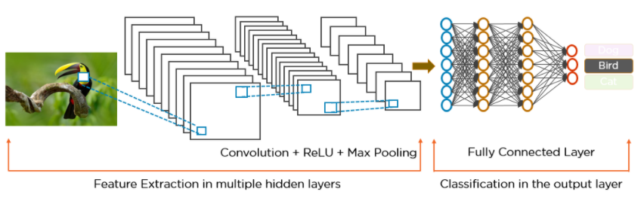
Here’s how exactly CNN recognizes a bird:

Slide 16
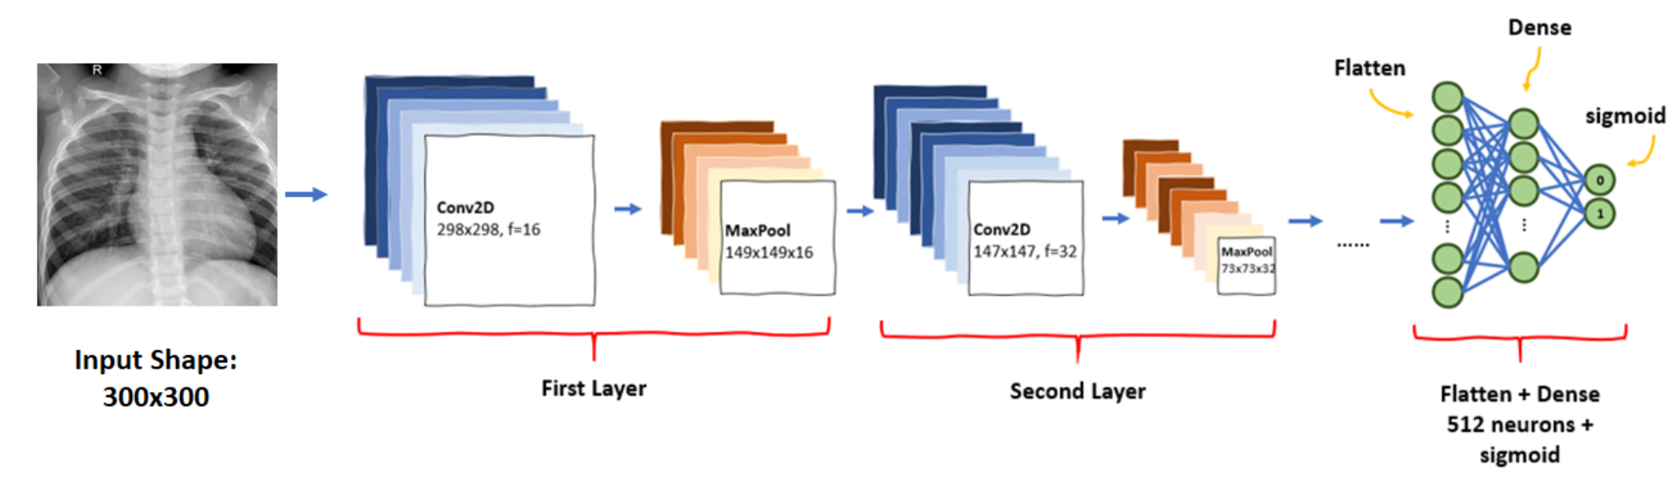
MODEL BUILDING OF PNEUMONIA PREDICTION USING CNN:
The main objective of this project is to help the doctors to predict the pneumonia disease more accurately using a deep learning model. The objective is not only to help the doctors but also to the patients to verify whether they have pneumonia or not. By using this model we can precisely predict pneumonia. A convolutional neural network model is built from scratch to extract features from a given chest X-ray image and classify it to determine if a person is infected with pneumonia. a web is built where the user can upload the x - ray image and the result is shown on the UI.

Slide 17
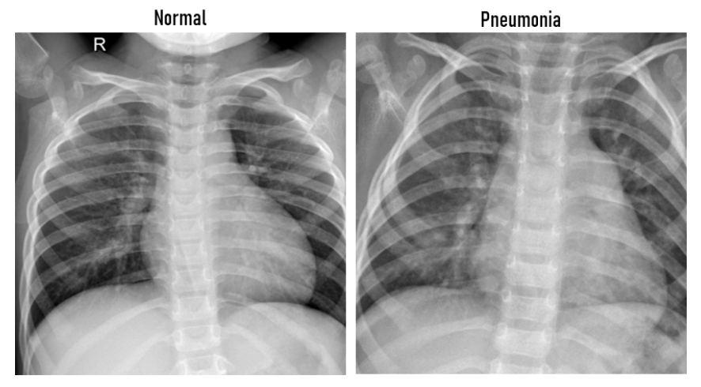
STEPS INVOLVED IN MODEL BUILDING OF PNEUMONIA PREDICTION USING CNN:
1. We load the data.
2.Create separate folders like Train, Test and validate folders.
3.Import model building libraries from keras like :
Sequential
Dense
Convolution 2D
Maxpooling 2D
Flatten
ImageDataGenerator
4. Apply ImageDataGenerator to Trainset and Testset.
5.Loading the preprocessed data.
6.Initializing the model/adding layers.
These are the chest x-rays of normal and infected persons of pneumonia patients used for test and train the model.

Slide 18
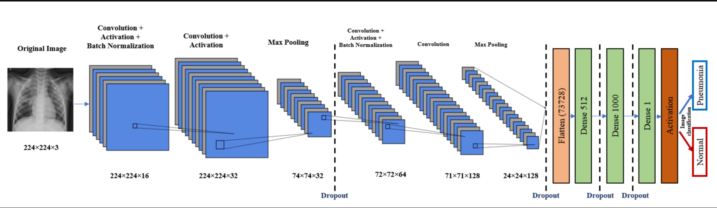
7. Training and Testing
the model[accuracy
of model= 91%].
8.Flask integration
for the
implementation of
user interface.
LINK TO ACCESS MY PNEUMONIA PREDICTION MODEL: PNEUMONIA PREDICTION USING CNN USER INTERFACE [U.I] LINK

Slide 19
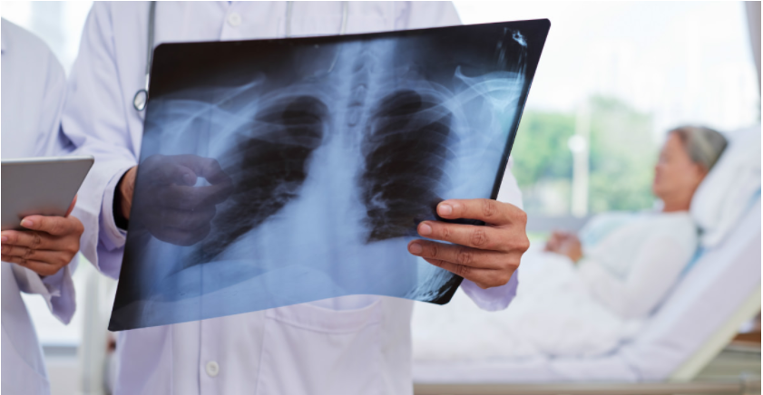

CONCLUSION:
The pneumonia prediction model using CNN a deep learning algorithm will help the patients to diagonize their health problem by saving the time for the prediction of the problem. This model was the best fit model in the medical field because it gives the results of the patients accurately without any marginal error and the the doctors can clearly have the test report of the patient by using this model and then the doctor can immediately go for further treatment to cure the illness of the patient without any negligence in the test reports.
In the future, many fields irrespective of their work use the technology of AI and ML to make their work smother and tackle the business problems in a efficient, rapid and better way for the promising future of the world tomorrow.
SAVE THE LIVES OF PNEUMONIA PATIENTS AS A RESPONSIBLE CITIZEN.

